Slide 1
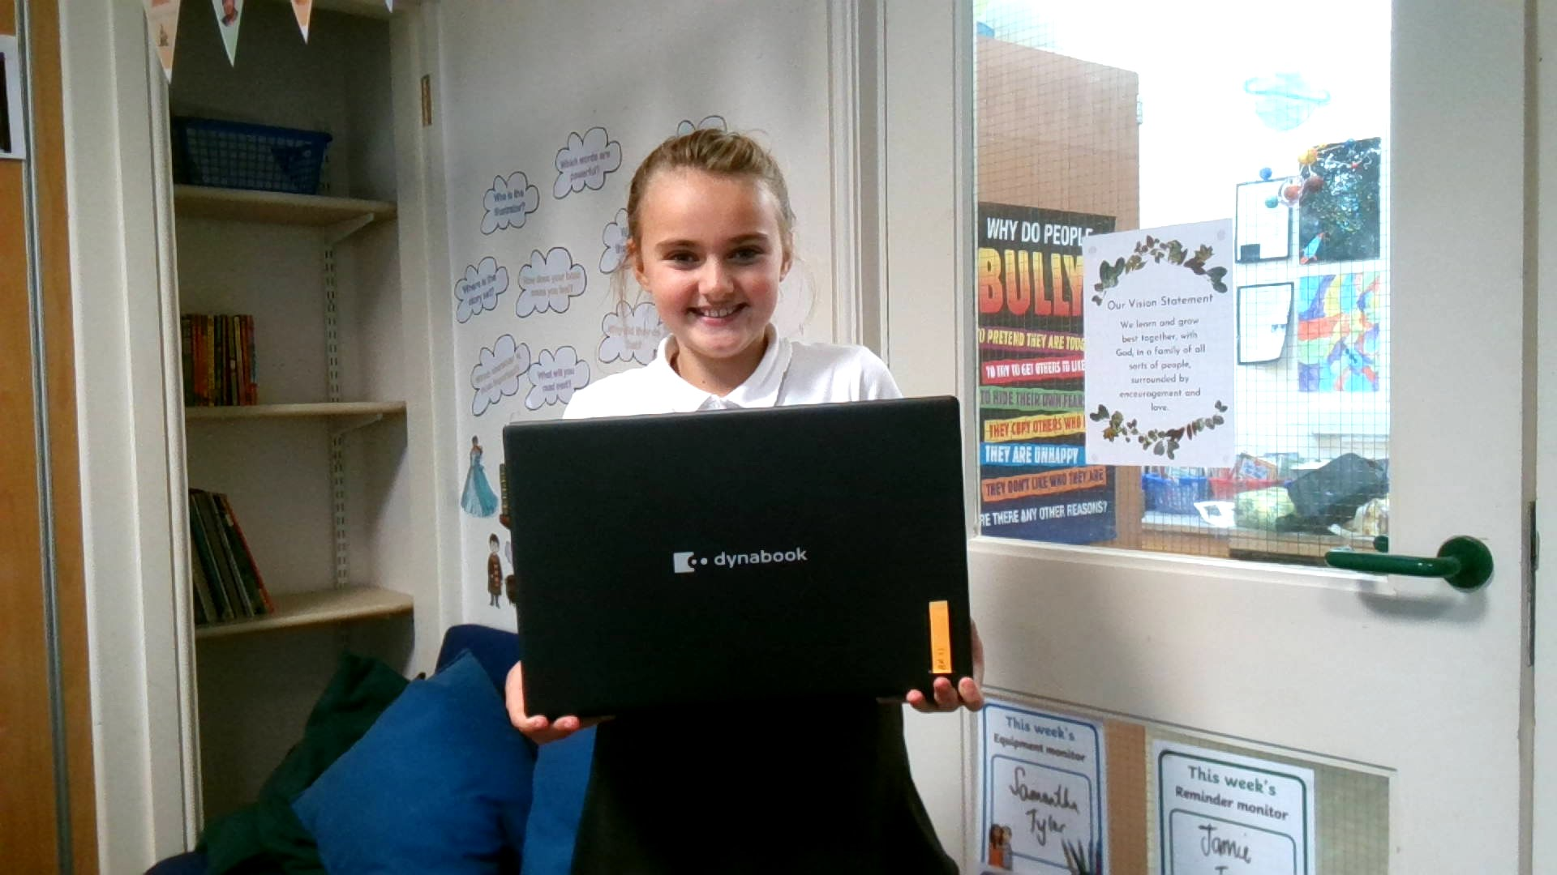
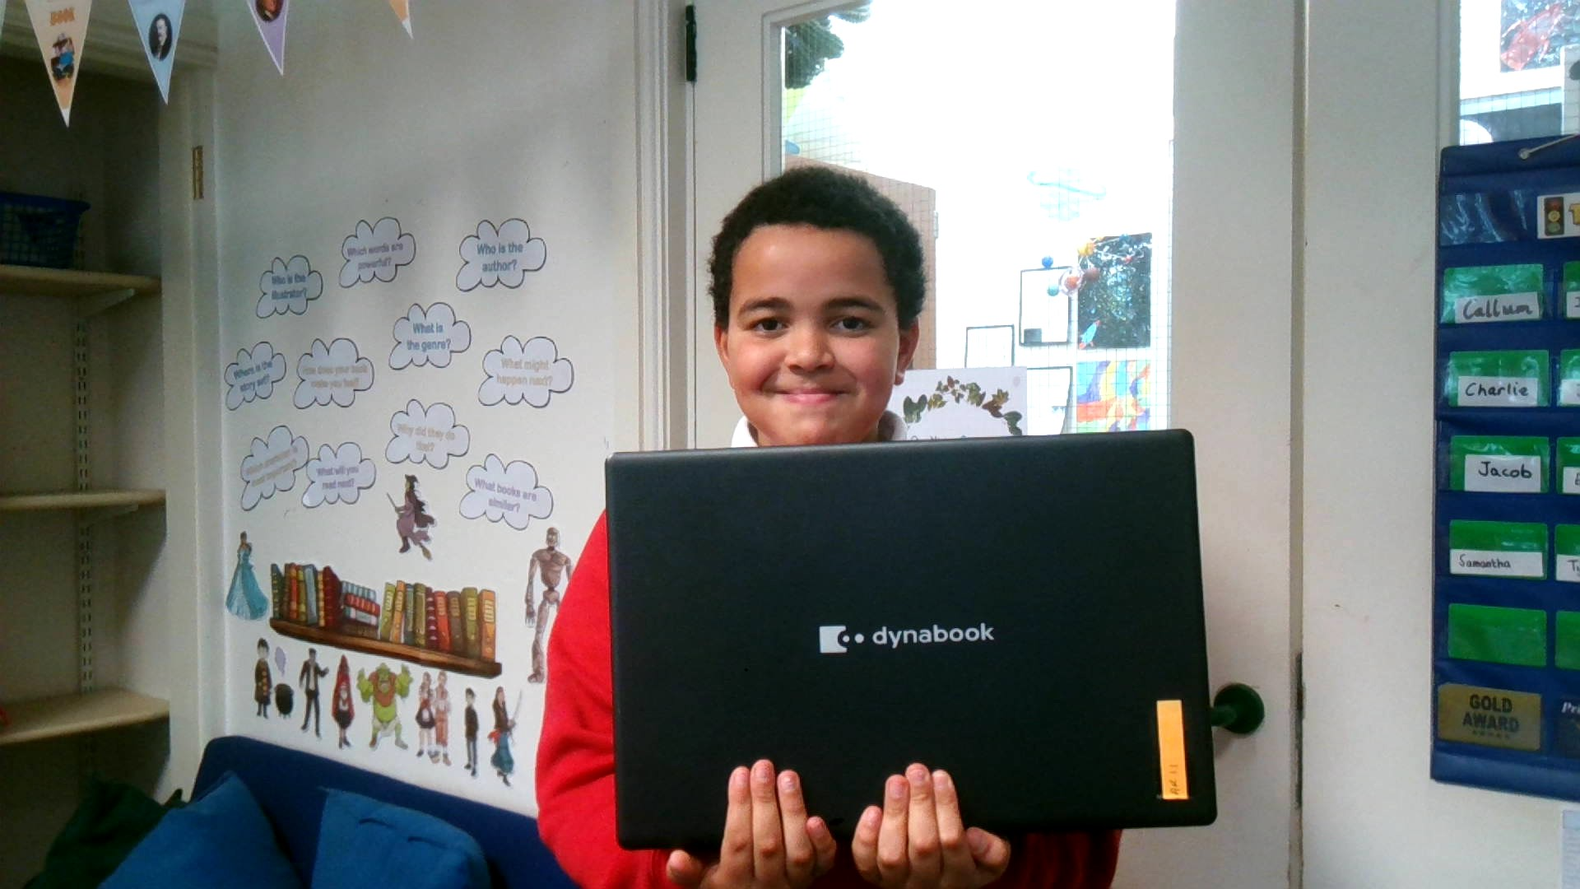
i-vengers UNITE! We are the i-vengers from Tintwistle C of E Primary school

Slide 2
Who are we?
Hi we are the i-vengers and our names are ____ and ___. Something you might like to know about me is that I play piano and play football.
Something you like to know about me is I like to play games that are suitable.

Slide 3
What is an i-venger?
1.We`re leaders in online safety.
2.We`re going to help everyone else learn about
online safety – including teachers and parents.
3.We`re going to help everyone make safer
choices online.
4.To be an I-venger it means to keep everyone safe online!

Slide 4
Our Tasks
We have tasks and secret missions to complete.
Our first task is to do this assembly to
introduce ourselves to you and explain what
I-vengers do.

Slide 5
What is our next task?
Christmas is around the corner and lots of children will be privileged enough to receive new devices that connect to the internet.
You might get something like, computer games, mobile phones, laptops, tablets or a games console.
With this in mind our jobs are to make sure you are prepared to use them safely.

Slide 6
What is our next task ?
Our second task is to get every class to come up with THREE top
Online safety tips.
We are going to put these into a list and share it with you on our I-vengers webpage on the school website. We are also going to be sharing these with parents.
You will be completing the sheet we have made.

Slide 7
What is our next task ?
We need each class to present us with three top tips at the start of next week. Please vote on your favourite three and send them through to I-vengers HQ (in Class 4).
Thank you for your help and for listening!

Slide 8
THE ONLINE WORLD NEEDS HEROES…
HEROES LIKE YOU!

